Slide 1

Central Limit Theorem
$$\overline{x} Distribution$$
- the $\overline{x}$ distribution is a normal distribution
- the mean of the $\overline{x}$ distribution is $μ$
- the standard deviation is $\frac{σ}{\sqrt{n}}$

Slide 2

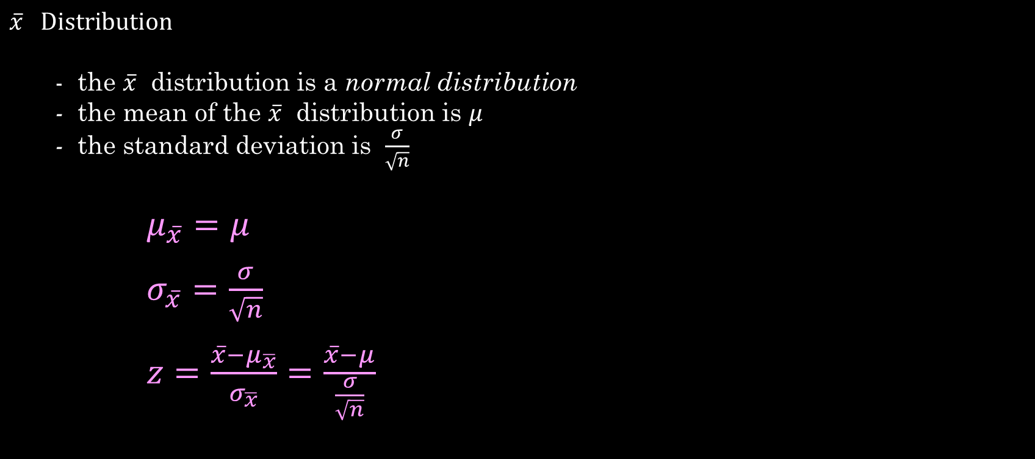
Central Limit Theorem
$$\overline{x} Distribution$$
- the $\overline{x}$ distribution is a normal distribution
- the mean of the $\overline{x}$ distribution is $μ$
- the standard deviation is $\frac{σ}{\sqrt{n}}$
$μ_{\overline{x}}=μ$
$σ_{\overline{x}}=\frac{σ}{\sqrt{n}}$
$z=\frac{\overline{x}−μ_{\overline{x}}}{σ_{\overline{x}}}=\frac{\overline{x}−μ}{\frac{σ}{\sqrt{n}}}$
Where $n$ is the sample size
$μ$ is the mean of the $x$ distribution
$σ$ is the standard deviation of the $x$ distibution

Slide 3

Central Limit Theorem
Suppose a team of biologists are studying the Pindale children’s fishing pond. Let $x$ represent the length of a single trout taken at random from the pond. This group of biologists has determined that $x$ has a normal distribution with $μ=10.2$ inches and $σ=1.4$ inches.

Slide 4

Central Limit Theorem
Suppose a team of biologists are studying the Pindale children’s fishing pond. Let $x$ represent the length of a single trout taken at random from the pond. This group of biologists has determined that $x$ has a normal distribution with $μ=10.2$ inches and $σ=1.4$ inches.
a) What is the probability that a single trout taken at random from the pond is between 8 and 12 inches long ?

Slide 5

Central Limit Theorem
Suppose a team of biologists are studying the Pindale children’s fishing pond. Let $x$ represent the length of a single trout taken at random from the pond. This group of biologists has determined that $x$ has a normal distribution with $μ=10.2$ inches and $σ=1.4$ inches.
What is the probability that a single trout taken at random from the pond is between 8 and 12 inches long ?
  $$z\left(x=8\right)=\frac{x−μ}{σ}=\frac{8−10.2}{1.4}=\frac{−2.2}{1.4}=−1.57$$
  $$z\left(x=12\right)=\frac{x−μ}{σ}=\frac{12−10.2}{1.4}=\frac{1.8}{1.4}=1.29$$

Slide 6

Central Limit Theorem
Suppose a team of biologists are studying the Pindale children’s fishing pond. Let $x$ represent the length of a single trout taken at random from the pond. This group of biologists has determined that $x$ has a normal distribution with $μ=10.2$ inches and $σ=1.4$ inches.
What is the probability that a single trout taken at random from the pond is between 8 and 12 inches long ?
  $$z\left(x=8\right)=\frac{x−μ}{σ}=\frac{8−10.2}{1.4}=\frac{−2.2}{1.4}=−1.57$$
  $$z\left(x=12\right)=\frac{x−μ}{σ}=\frac{12−10.2}{1.4}=\frac{1.8}{1.4}=1.29$$
  $$P\left(−1.57<z<1.29\right)=0.9015−0.0582=0.8433$$

Slide 7

Central Limit Theorem
Suppose a team of biologists are studying the Pindale children’s fishing pond. Let $x$ represent the length of a single trout taken at random from the pond. This group of biologists has determined that $x$ has a normal distribution with $μ=10.2$ inches and $σ=1.4$ inches.
What is the probability that a single trout taken at random from the pond is between 8 and 12 inches long ?
  $$z\left(x=8\right)=\frac{x−μ}{σ}=\frac{8−10.2}{1.4}=\frac{−2.2}{1.4}=−1.57$$
  $$z\left(x=12\right)=\frac{x−μ}{σ}=\frac{12−10.2}{1.4}=\frac{1.8}{1.4}=1.29$$
  $$P\left(−1.57<z<1.29\right)=0.9015−0.0582=0.8433$$
  So the probability = 0.8433 that a single trout taken from the pond will be
  8 – 12 inches long

Slide 8
Central Limit Theorem
b) What is the probability that the mean length $\overline{x}$of five trout taken at random from the pond is between 8 and 12 inches long.

Slide 9

Central Limit Theorem
What is the probability that the mean length $\overline{x}$of five trout taken at random from the pond is between 8 and 12 inches long.
Let $μ_{\overline{x}}$ represent the mean of the distribution

Slide 10

Central Limit Theorem
What is the probability that the mean length $\overline{x}$of five trout taken at random from the pond is between 8 and 12 inches long.
Let $μ_{\overline{x}}$ represent the mean of the distribution
Then $μ_{\overline{x}}=μ=10.2$

Slide 11

Central Limit Theorem
What is the probability that the mean length $\overline{x}$of five trout taken at random from the pond is between 8 and 12 inches long.
Let $μ_{\overline{x}}$ represent the mean of the distribution
Then $μ_{\overline{x}}=μ=10.2$
If $σ_{\overline{x}}=σ/{\sqrt{n}}$ represents the standard deviation of the distribution

Slide 12

Central Limit Theorem
What is the probability that the mean length $\overline{x}$of five trout taken at random from the pond is between 8 and 12 inches long.
Let $μ_{\overline{x}}$ represent the mean of the distribution
Then $μ_{\overline{x}}=μ=10.2$
If $σ_{\overline{x}}=σ/{\sqrt{n}}$ represents the standard deviation of the distribution
Then $σ_{\overline{x}}={1.4}/{\sqrt{5}}=0.63$

Slide 13

Central Limit Theorem
What is the probability that the mean length $\overline{x}$of five trout taken at random from the pond is between 8 and 12 inches long.
Let $μ_{\overline{x}}$ represent the mean of the distribution
Then $μ_{\overline{x}}=μ=10.2$
If $σ_{\overline{x}}=σ/{\sqrt{n}}$ represents the standard deviation of the distribution
Then $σ_{\overline{x}}={1.4}/{\sqrt{5}}=0.63$
So now $\overline{x}=8 , 12$

Slide 14

Central Limit Theorem
What is the probability that the mean length $\overline{x}$of five trout taken at random from the pond is between 8 and 12 inches long.
Let $μ_{\overline{x}}$ represent the mean of the distribution
Then $μ_{\overline{x}}=μ=10.2$
If $σ_{\overline{x}}=σ/{\sqrt{n}}$ represents the standard deviation of the distribution
Then $σ_{\overline{x}}={1.4}/{\sqrt{5}}=0.63$
So now $\overline{x}=8 , 12$
$z\left(\overline{x}=8\right)=\frac{\overline{x}−μ_{\overline{x}}}{σ_{\overline{x}}}=\frac{\overline{x}−μ}{σ/{\sqrt{n}}}=\frac{8−10.2}{0.63}=−3.49$

Slide 15

Central Limit Theorem
What is the probability that the mean length $\overline{x}$of five trout taken at random from the pond is between 8 and 12 inches long.
Let $μ_{\overline{x}}$ represent the mean of the distribution
Then $μ_{\overline{x}}=μ=10.2$
If $σ_{\overline{x}}=σ/{\sqrt{n}}$ represents the standard deviation of the distribution
Then $σ_{\overline{x}}={1.4}/{\sqrt{5}}=0.63$
So now $\overline{x}=8 , 12$
$z\left(\overline{x}=8\right)=\frac{\overline{x}−μ_{\overline{x}}}{σ_{\overline{x}}}=\frac{\overline{x}−μ}{σ/{\sqrt{n}}}=\frac{8−10.2}{0.63}=−3.49$
$z\left(\overline{x}=12\right)=\frac{\overline{x}−μ_{\overline{x}}}{σ_{\overline{x}}}=\frac{\overline{x}−μ}{σ/{\sqrt{n}}}=\frac{12−10.2}{0.63}=2.86$

Slide 16
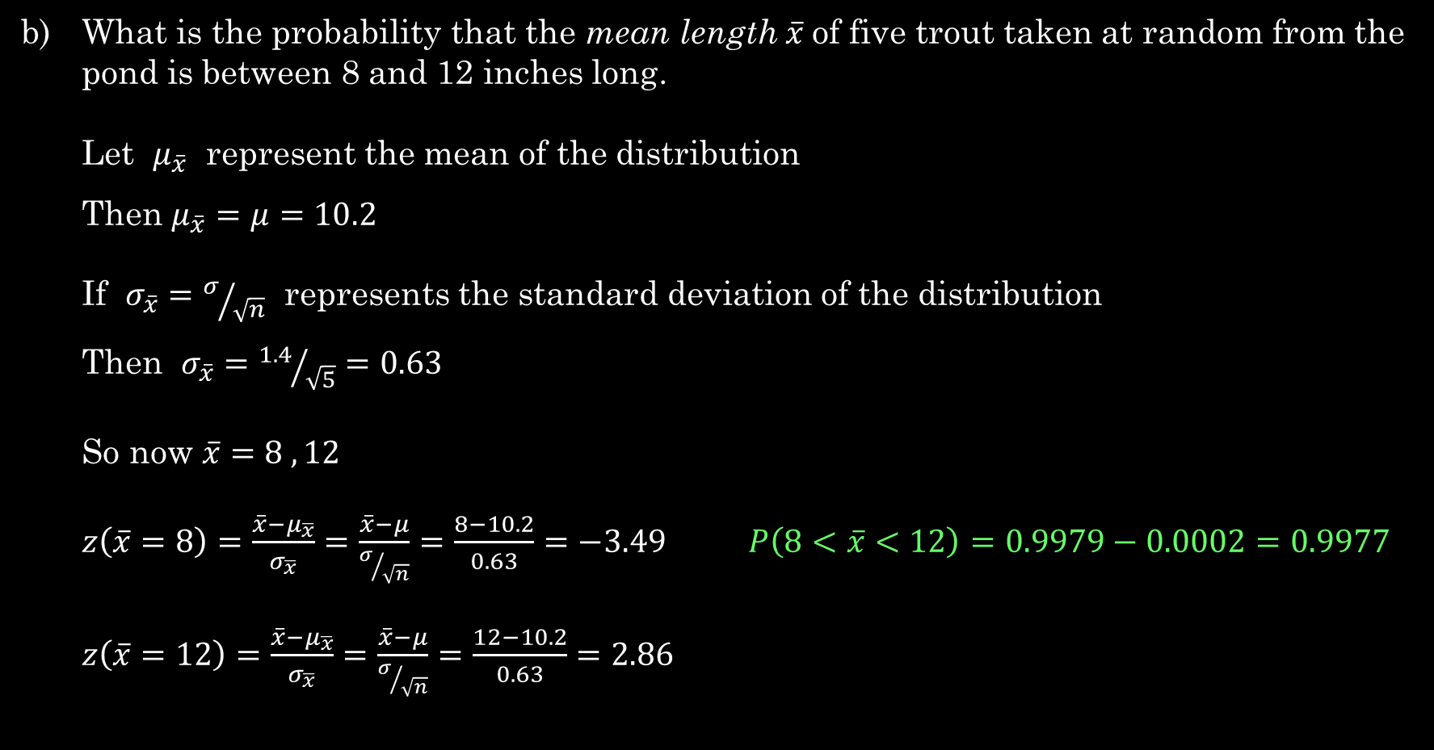
Central Limit Theorem
What is the probability that the mean length $\overline{x}$of five trout taken at random from the pond is between 8 and 12 inches long.
Let $μ_{\overline{x}}$ represent the mean of the distribution
Then $μ_{\overline{x}}=μ=10.2$
If $σ_{\overline{x}}=σ/{\sqrt{n}}$ represents the standard deviation of the distribution
Then $σ_{\overline{x}}={1.4}/{\sqrt{5}}=0.63$
So now $\overline{x}=8 , 12$
$z\left(\overline{x}=8\right)=\frac{\overline{x}−μ_{\overline{x}}}{σ_{\overline{x}}}=\frac{\overline{x}−μ}{σ/{\sqrt{n}}}=\frac{8−10.2}{0.63}=−3.49$ $P\left(8<\overline{x}<12\right)=0.9979−0.0002=0.9977$
$z\left(\overline{x}=12\right)=\frac{\overline{x}−μ_{\overline{x}}}{σ_{\overline{x}}}=\frac{\overline{x}−μ}{σ/{\sqrt{n}}}=\frac{12−10.2}{0.63}=2.86$

Slide 17
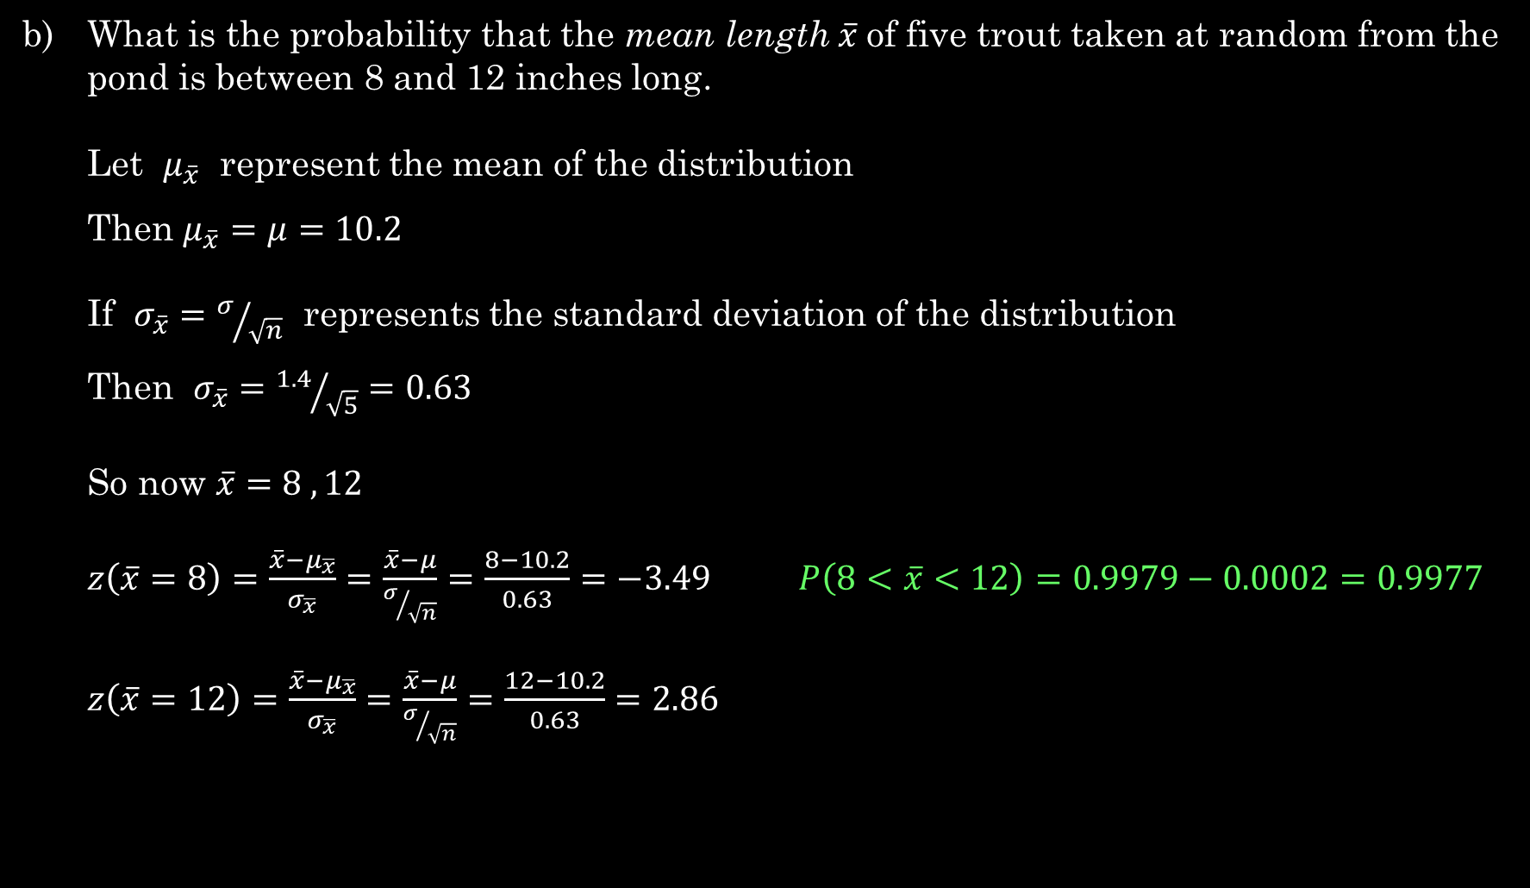
Central Limit Theorem
What is the probability that the mean length $\overline{x}$of five trout taken at random from the pond is between 8 and 12 inches long.
Let $μ_{\overline{x}}$ represent the mean of the distribution
Then $μ_{\overline{x}}=μ=10.2$
If $σ_{\overline{x}}=σ/{\sqrt{n}}$ represents the standard deviation of the distribution
Then $σ_{\overline{x}}={1.4}/{\sqrt{5}}=0.63$
So now $\overline{x}=8 , 12$
$z\left(\overline{x}=8\right)=\frac{\overline{x}−μ_{\overline{x}}}{σ_{\overline{x}}}=\frac{\overline{x}−μ}{σ/{\sqrt{n}}}=\frac{8−10.2}{0.63}=−3.49$ $P\left(8<\overline{x}<12\right)=0.9979−0.0002=0.9977$
$z\left(\overline{x}=12\right)=\frac{\overline{x}−μ_{\overline{x}}}{σ_{\overline{x}}}=\frac{\overline{x}−μ}{σ/{\sqrt{n}}}=\frac{12−10.2}{0.63}=2.86$
The probability = 0.9977 that the mean length based on a sample size of 5 is between 8 and 12 inches.

Slide 18

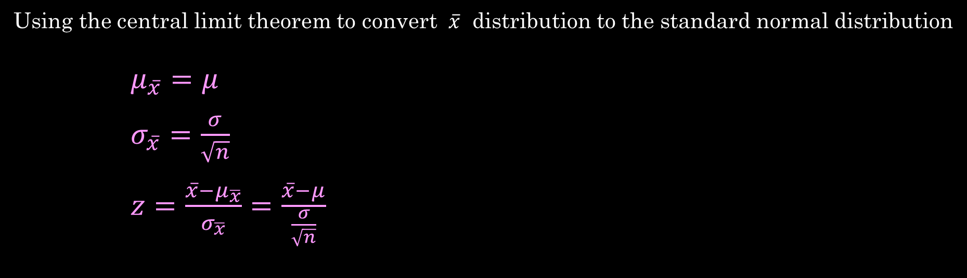
Central Limit Theorem
Using the central limit theorem to convert $\overline{x}$ distribution to the standard normal distribution
$μ_{\overline{x}}=μ$
$σ_{\overline{x}}=\frac{σ}{\sqrt{n}}$
$z=\frac{\overline{x}−μ_{\overline{x}}}{σ_{\overline{x}}}=\frac{\overline{x}−μ}{\frac{σ}{\sqrt{n}}}$
Where $n$ is the sample size $(n≥30)$
$μ$ is the mean of the $x$ distribution
$σ$ is the standard deviation of the $x$ distibution

Slide 19

Central Limit Theorem
EXAMPLE : Suppose $x$ has a normal distribution with mean $μ=18$ and standard
deviation $σ=3$. If you draw random samples of 8 from the $x$ distribution
and $\overline{x}$represents the sample mean, what can we say about the $\overline{x}$
distribution ?

Slide 20

Central Limit Theorem
EXAMPLE : Suppose $x$ has a normal distribution with mean $μ=18$ and standard
deviation $σ=3$. If you draw random samples of 8 from the $x$ distribution
and $\overline{x}$represents the sample mean, what can we say about the $\overline{x}$
distribution ?
SOLUTION : Find $μ_{\overline{x}}$ and $σ_{\overline{x}}$

Slide 21
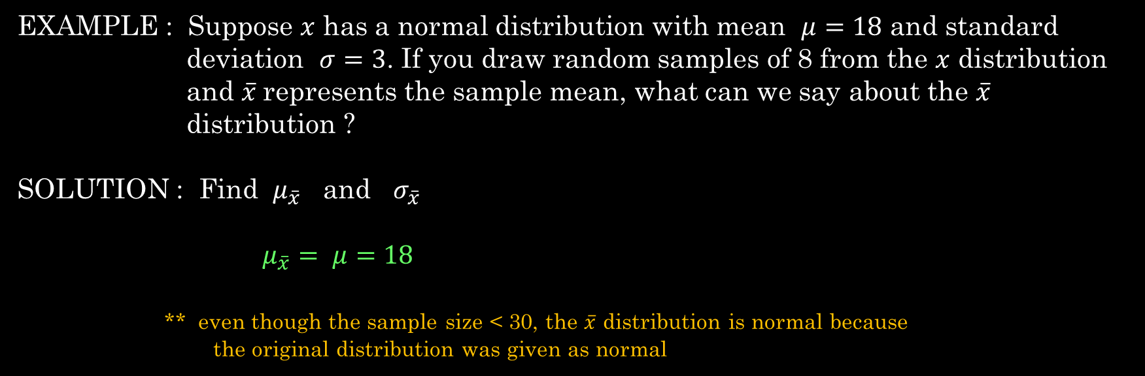
Central Limit Theorem
EXAMPLE : Suppose $x$ has a normal distribution with mean $μ=18$ and standard
deviation $σ=3$. If you draw random samples of 8 from the $x$ distribution
and $\overline{x}$represents the sample mean, what can we say about the $\overline{x}$
distribution ?
SOLUTION : Find $μ_{\overline{x}}$ and $σ_{\overline{x}}$
$μ_{\overline{x}}= μ=18$
** even though the sample size < 30, the $\overline{x}$ distribution is normal because
the original distribution was given as normal

Slide 22
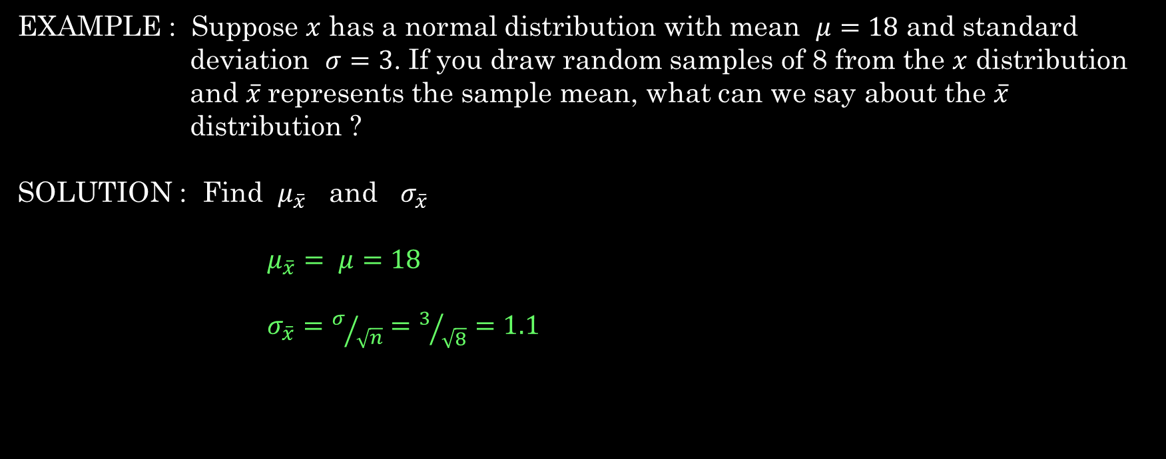
Central Limit Theorem
EXAMPLE : Suppose $x$ has a normal distribution with mean $μ=18$ and standard
deviation $σ=3$. If you draw random samples of 8 from the $x$ distribution
and $\overline{x}$represents the sample mean, what can we say about the $\overline{x}$
distribution ?
SOLUTION : Find $μ_{\overline{x}}$ and $σ_{\overline{x}}$
$μ_{\overline{x}}= μ=18$
$σ_{\overline{x}}=σ/{\sqrt{n}}=3/{\sqrt{8}}=1.1$

Slide 23
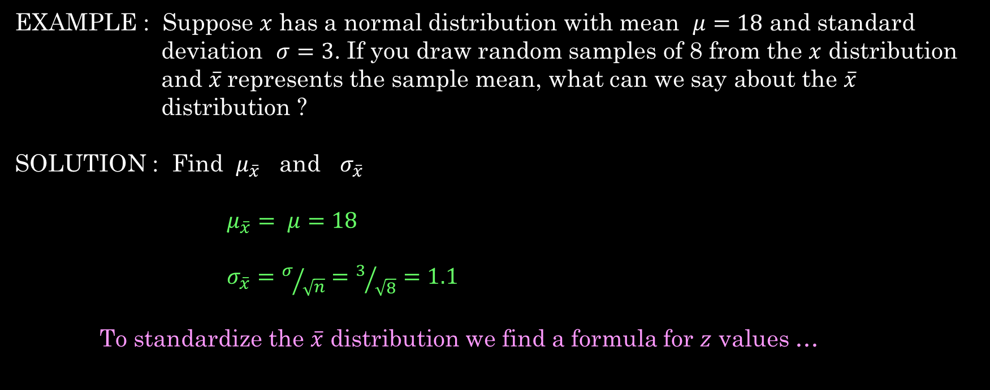
Central Limit Theorem
EXAMPLE : Suppose $x$ has a normal distribution with mean $μ=18$ and standard
deviation $σ=3$. If you draw random samples of 8 from the $x$ distribution
and $\overline{x}$represents the sample mean, what can we say about the $\overline{x}$
distribution ?
SOLUTION : Find $μ_{\overline{x}}$ and $σ_{\overline{x}}$
$μ_{\overline{x}}= μ=18$
$σ_{\overline{x}}=σ/{\sqrt{n}}=3/{\sqrt{8}}=1.1$
To standardize the $\overline{x}$ distribution we find a formula for $z$ values …

Slide 24
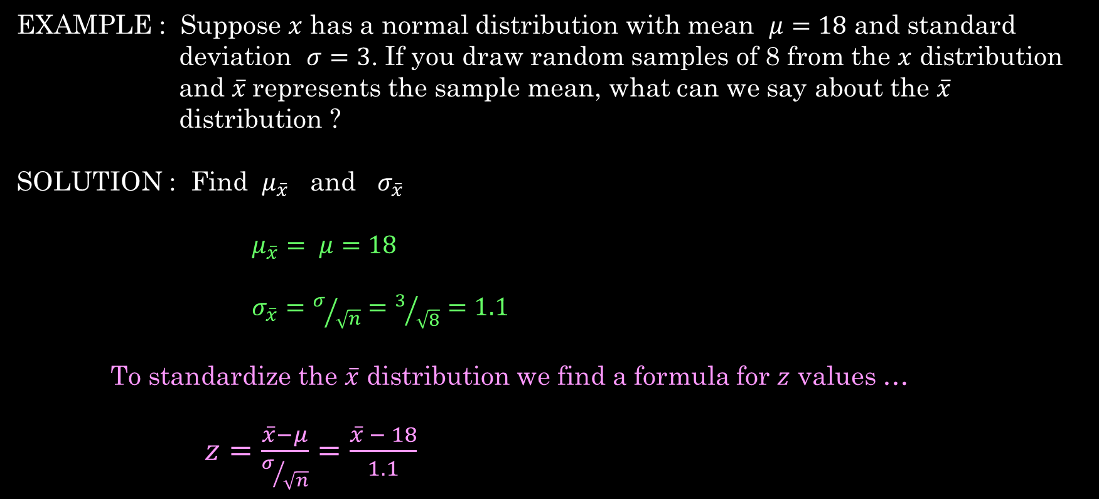
Central Limit Theorem
EXAMPLE : Suppose $x$ has a normal distribution with mean $μ=18$ and standard
deviation $σ=3$. If you draw random samples of 8 from the $x$ distribution
and $\overline{x}$represents the sample mean, what can we say about the $\overline{x}$
distribution ?
SOLUTION : Find $μ_{\overline{x}}$ and $σ_{\overline{x}}$
$μ_{\overline{x}}= μ=18$
$σ_{\overline{x}}=σ/{\sqrt{n}}=3/{\sqrt{8}}=1.1$
To standardize the $\overline{x}$ distribution we find a formula for $z$ values …
$z=\frac{\overline{x}−μ}{σ/{\sqrt{n}}}=\frac{\overline{x} − 18}{1.1}$

Slide 25
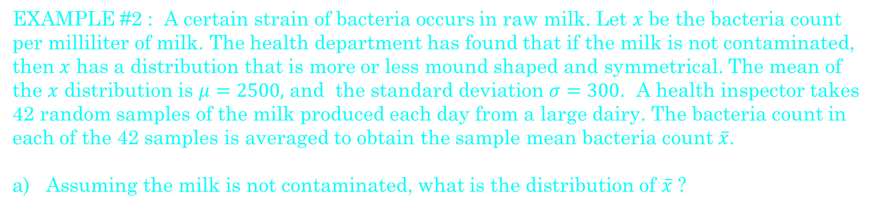
Central Limit Theorem
EXAMPLE #2 : A certain strain of bacteria occurs in raw milk. Let $x$ be the bacteria count per milliliter of milk. The health department has found that if the milk is not contaminated, then $x$ has a distribution that is more or less mound shaped and symmetrical. The mean of the $x$ distribution is $μ=2500,$ and the standard deviation $σ=300$. A health inspector takes 42 random samples of the milk produced each day from a large dairy. The bacteria count in each of the 42 samples is averaged to obtain the sample mean bacteria count $\overline{x}$.
a) Assuming the milk is not contaminated, what is the distribution of $\overline{x}$ ?

Slide 26
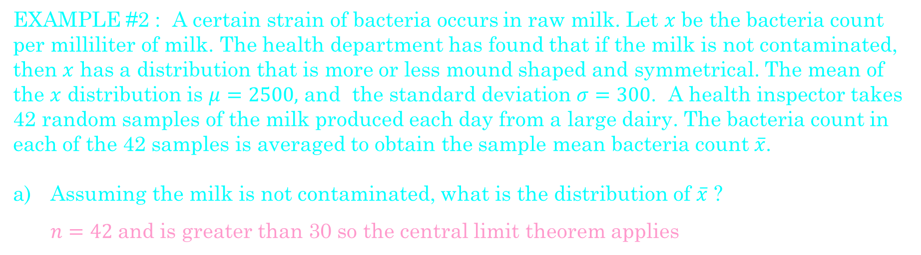
Central Limit Theorem
EXAMPLE #2 : A certain strain of bacteria occurs in raw milk. Let $x$ be the bacteria count per milliliter of milk. The health department has found that if the milk is not contaminated, then $x$ has a distribution that is more or less mound shaped and symmetrical. The mean of the $x$ distribution is $μ=2500,$ and the standard deviation $σ=300$. A health inspector takes 42 random samples of the milk produced each day from a large dairy. The bacteria count in each of the 42 samples is averaged to obtain the sample mean bacteria count $\overline{x}$.
Assuming the milk is not contaminated, what is the distribution of $\overline{x}$ ?
  $n=42$and is greater than 30 so the central limit theorem applies

Slide 27
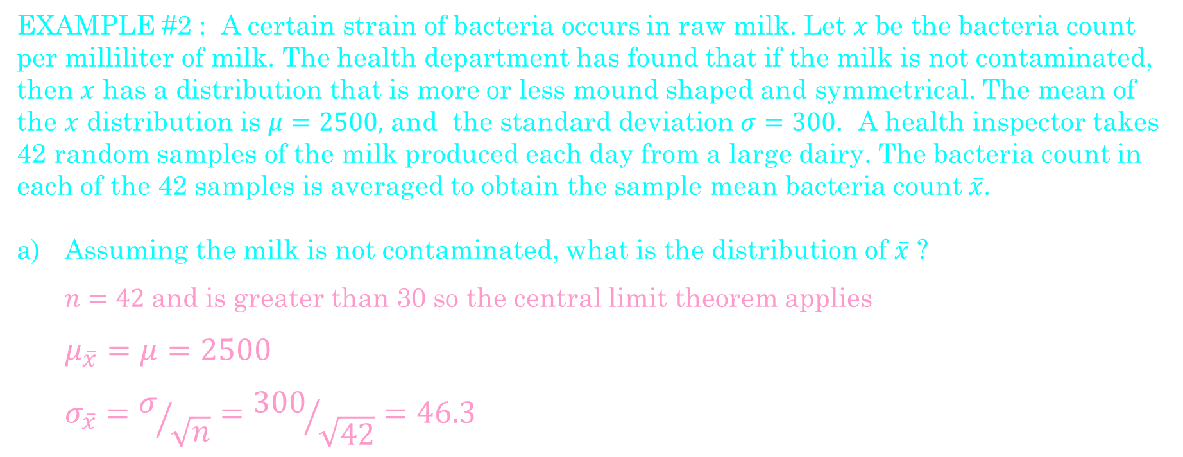
Central Limit Theorem
EXAMPLE #2 : A certain strain of bacteria occurs in raw milk. Let $x$ be the bacteria count per milliliter of milk. The health department has found that if the milk is not contaminated, then $x$ has a distribution that is more or less mound shaped and symmetrical. The mean of the $x$ distribution is $μ=2500,$ and the standard deviation $σ=300$. A health inspector takes 42 random samples of the milk produced each day from a large dairy. The bacteria count in each of the 42 samples is averaged to obtain the sample mean bacteria count $\overline{x}$.
Assuming the milk is not contaminated, what is the distribution of $\overline{x}$ ?
  $n=42$and is greater than 30 so the central limit theorem applies
  $$μ_{\overline{x}}=μ=2500$$
  $$σ_{\overline{x}}=σ/{\sqrt{n}}={300}/{\sqrt{42}}=46.3$$

Slide 28
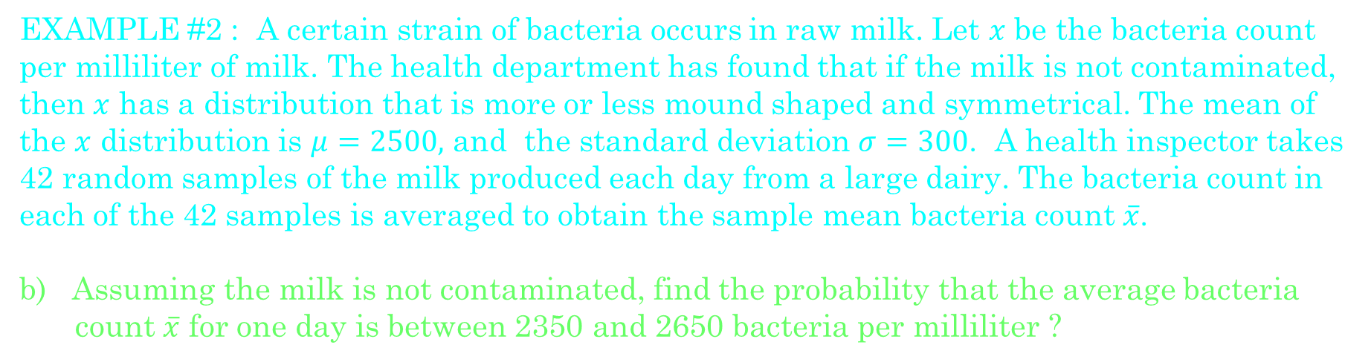
Central Limit Theorem
EXAMPLE #2 : A certain strain of bacteria occurs in raw milk. Let $x$ be the bacteria count per milliliter of milk. The health department has found that if the milk is not contaminated, then $x$ has a distribution that is more or less mound shaped and symmetrical. The mean of the $x$ distribution is $μ=2500,$ and the standard deviation $σ=300$. A health inspector takes 42 random samples of the milk produced each day from a large dairy. The bacteria count in each of the 42 samples is averaged to obtain the sample mean bacteria count $\overline{x}$.
b) Assuming the milk is not contaminated, find the probability that the average bacteria count $\overline{x}$ for one day is between 2350 and 2650 bacteria per milliliter ?

Slide 29
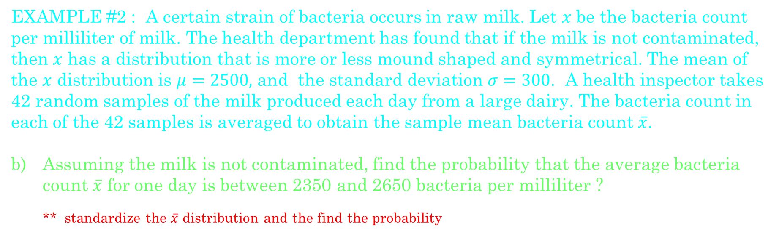
Central Limit Theorem
EXAMPLE #2 : A certain strain of bacteria occurs in raw milk. Let $x$ be the bacteria count per milliliter of milk. The health department has found that if the milk is not contaminated, then $x$ has a distribution that is more or less mound shaped and symmetrical. The mean of the $x$ distribution is $μ=2500,$ and the standard deviation $σ=300$. A health inspector takes 42 random samples of the milk produced each day from a large dairy. The bacteria count in each of the 42 samples is averaged to obtain the sample mean bacteria count $\overline{x}$.
Assuming the milk is not contaminated, find the probability that the average bacteria count $\overline{x}$ for one day is between 2350 and 2650 bacteria per milliliter ?
** standardize the $\overline{x}$ distribution and the find the probability

Slide 30
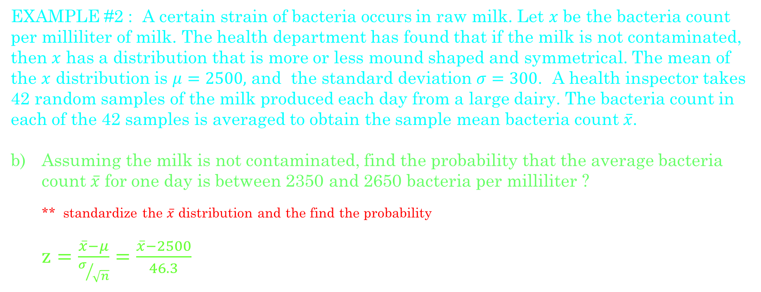
Central Limit Theorem
EXAMPLE #2 : A certain strain of bacteria occurs in raw milk. Let $x$ be the bacteria count per milliliter of milk. The health department has found that if the milk is not contaminated, then $x$ has a distribution that is more or less mound shaped and symmetrical. The mean of the $x$ distribution is $μ=2500,$ and the standard deviation $σ=300$. A health inspector takes 42 random samples of the milk produced each day from a large dairy. The bacteria count in each of the 42 samples is averaged to obtain the sample mean bacteria count $\overline{x}$.
Assuming the milk is not contaminated, find the probability that the average bacteria count $\overline{x}$ for one day is between 2350 and 2650 bacteria per milliliter ?
** standardize the $\overline{x}$ distribution and the find the probability
$z=\frac{\overline{x}−μ}{σ/{\sqrt{n}}}=\frac{\overline{x}−2500}{46.3}$

Slide 31
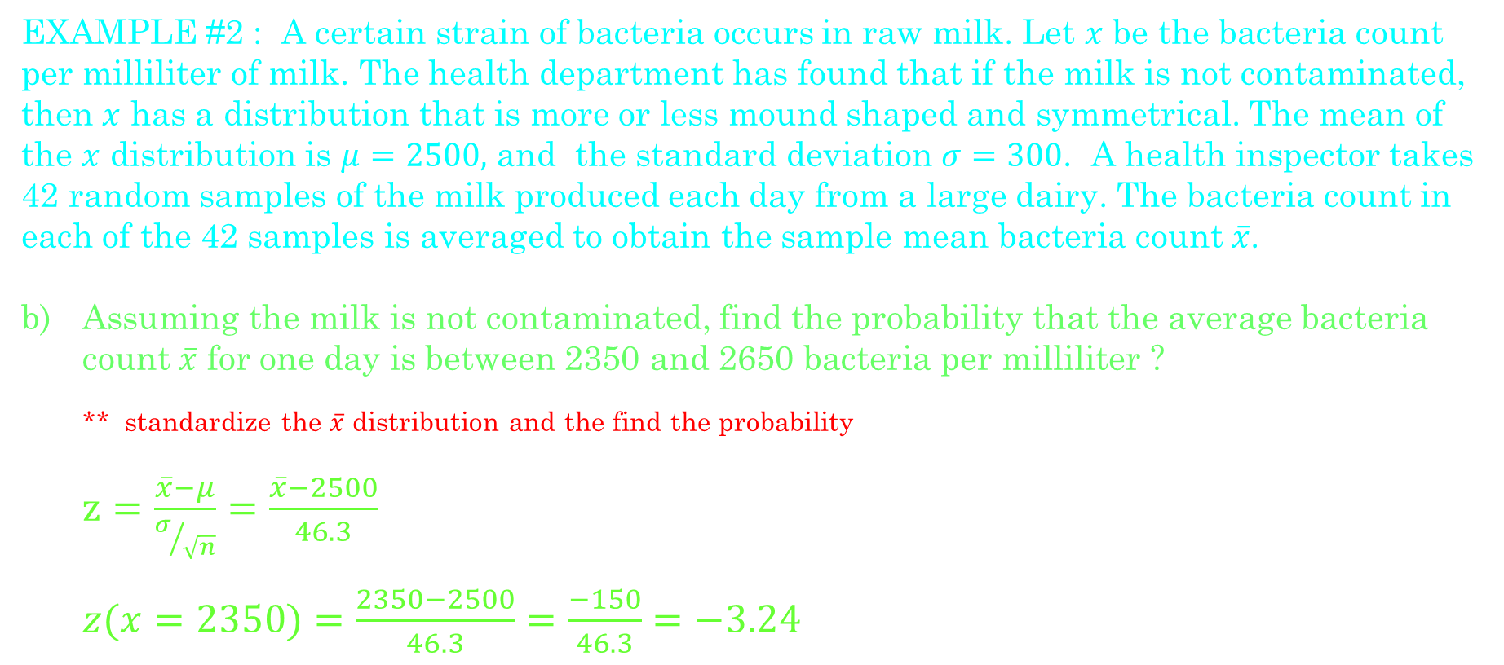
Central Limit Theorem
EXAMPLE #2 : A certain strain of bacteria occurs in raw milk. Let $x$ be the bacteria count per milliliter of milk. The health department has found that if the milk is not contaminated, then $x$ has a distribution that is more or less mound shaped and symmetrical. The mean of the $x$ distribution is $μ=2500,$ and the standard deviation $σ=300$. A health inspector takes 42 random samples of the milk produced each day from a large dairy. The bacteria count in each of the 42 samples is averaged to obtain the sample mean bacteria count $\overline{x}$.
Assuming the milk is not contaminated, find the probability that the average bacteria count $\overline{x}$ for one day is between 2350 and 2650 bacteria per milliliter ?
** standardize the $\overline{x}$ distribution and the find the probability
$z=\frac{\overline{x}−μ}{σ/{\sqrt{n}}}=\frac{\overline{x}−2500}{46.3}$
$z(x=2350)=\frac{2350−2500}{46.3}=\frac{−150}{46.3}=−3.24$

Slide 32
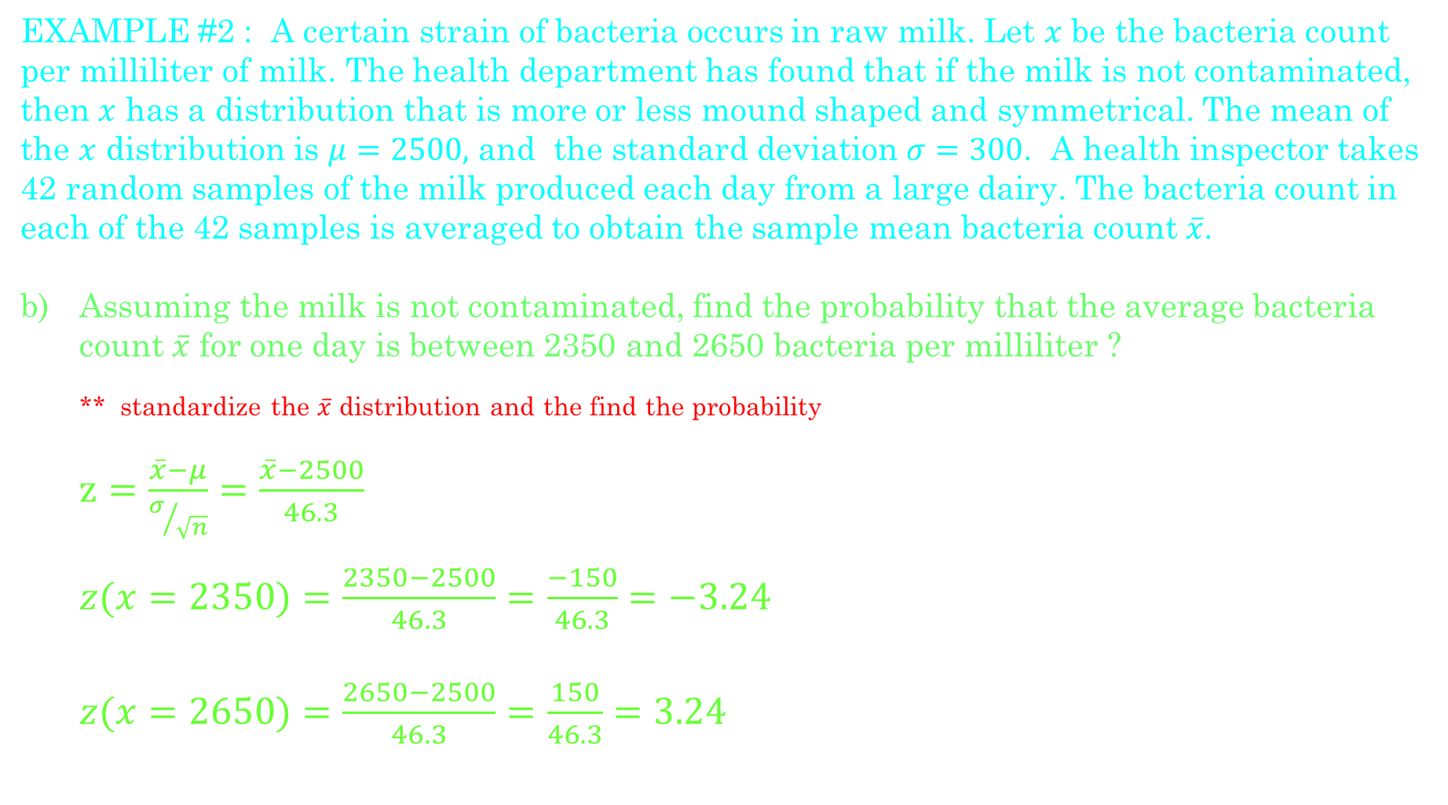
Central Limit Theorem
EXAMPLE #2 : A certain strain of bacteria occurs in raw milk. Let $x$ be the bacteria count per milliliter of milk. The health department has found that if the milk is not contaminated, then $x$ has a distribution that is more or less mound shaped and symmetrical. The mean of the $x$ distribution is $μ=2500,$ and the standard deviation $σ=300$. A health inspector takes 42 random samples of the milk produced each day from a large dairy. The bacteria count in each of the 42 samples is averaged to obtain the sample mean bacteria count $\overline{x}$.
Assuming the milk is not contaminated, find the probability that the average bacteria count $\overline{x}$ for one day is between 2350 and 2650 bacteria per milliliter ?
** standardize the $\overline{x}$ distribution and the find the probability
$z=\frac{\overline{x}−μ}{σ/{\sqrt{n}}}=\frac{\overline{x}−2500}{46.3}$
$z(x=2350)=\frac{2350−2500}{46.3}=\frac{−150}{46.3}=−3.24$
$z(x=2650)=\frac{2650−2500}{46.3}=\frac{150}{46.3}=3.24$

Slide 33
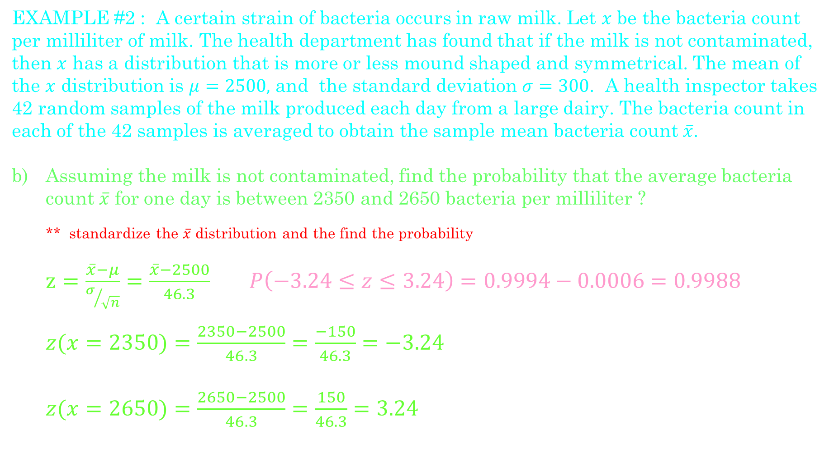
Central Limit Theorem
EXAMPLE #2 : A certain strain of bacteria occurs in raw milk. Let $x$ be the bacteria count per milliliter of milk. The health department has found that if the milk is not contaminated, then $x$ has a distribution that is more or less mound shaped and symmetrical. The mean of the $x$ distribution is $μ=2500,$ and the standard deviation $σ=300$. A health inspector takes 42 random samples of the milk produced each day from a large dairy. The bacteria count in each of the 42 samples is averaged to obtain the sample mean bacteria count $\overline{x}$.
Assuming the milk is not contaminated, find the probability that the average bacteria count $\overline{x}$ for one day is between 2350 and 2650 bacteria per milliliter ?
** standardize the $\overline{x}$ distribution and the find the probability
$z=\frac{\overline{x}−μ}{σ/{\sqrt{n}}}=\frac{\overline{x}−2500}{46.3}$ $P\left(−3.24≤z≤3.24\right)=0.9994−0.0006=0.9988$
$z(x=2350)=\frac{2350−2500}{46.3}=\frac{−150}{46.3}=−3.24$
$z(x=2650)=\frac{2650−2500}{46.3}=\frac{150}{46.3}=3.24$

